Slide 1
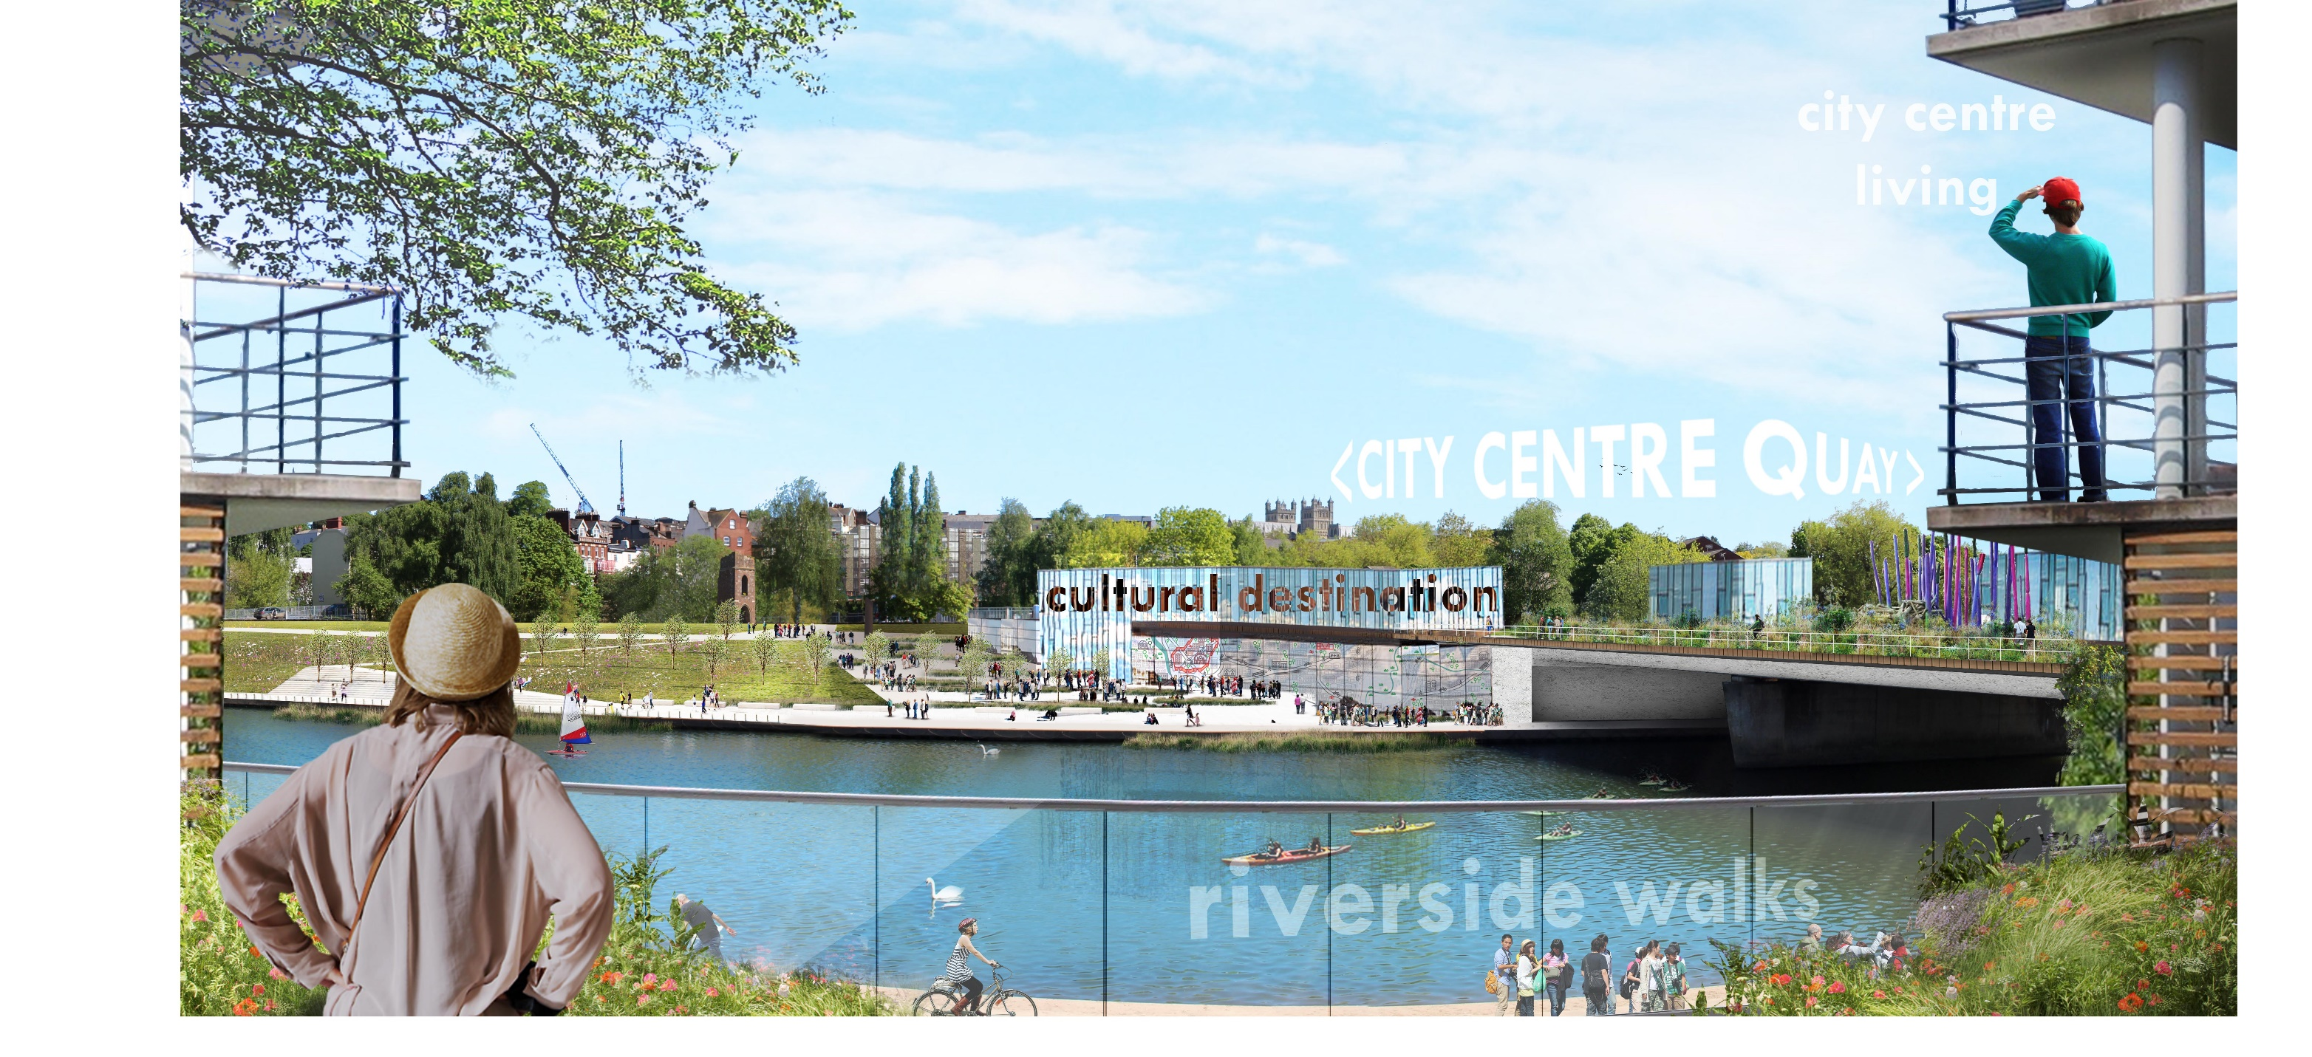


Liveable Cities and Placemaking
Lesson 1: Key Stage 4

Slide 2
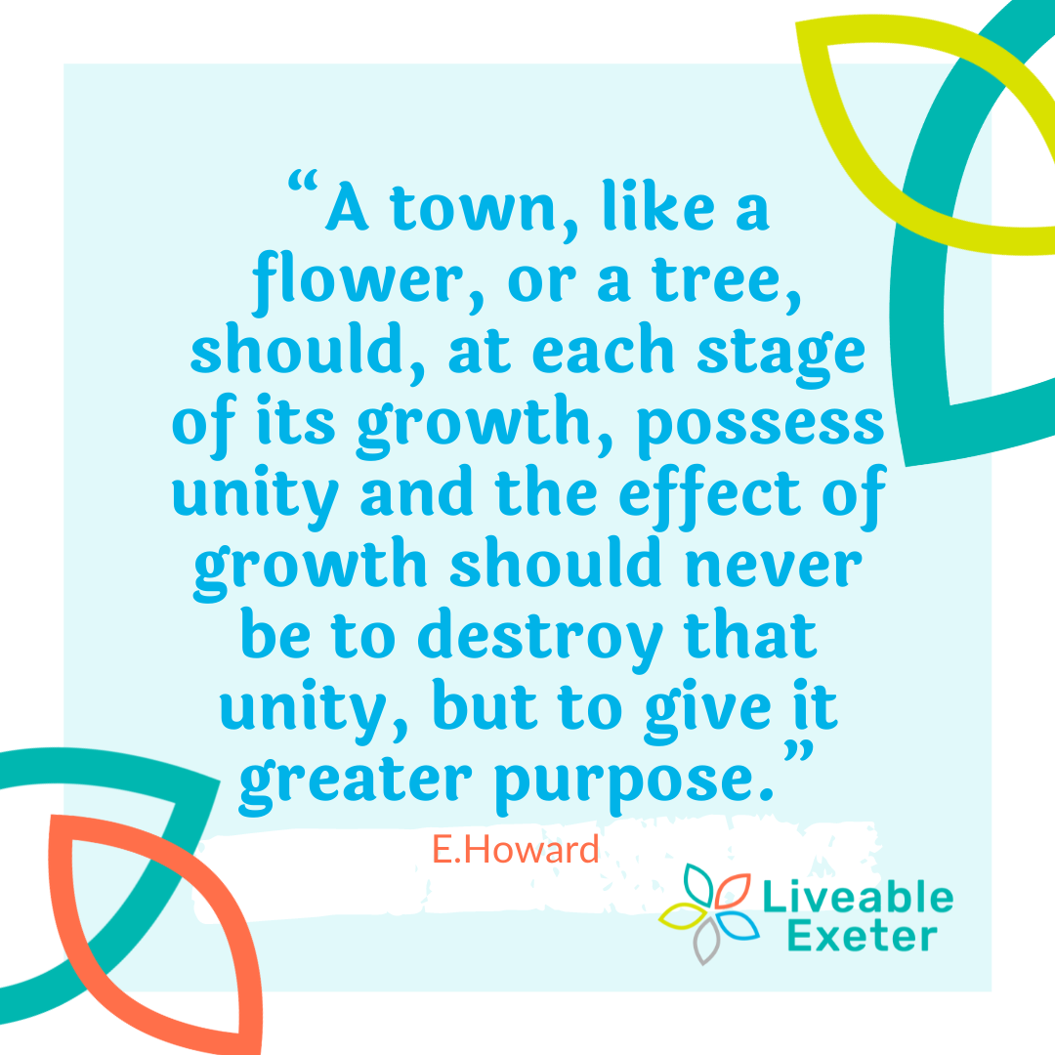


Slide 3
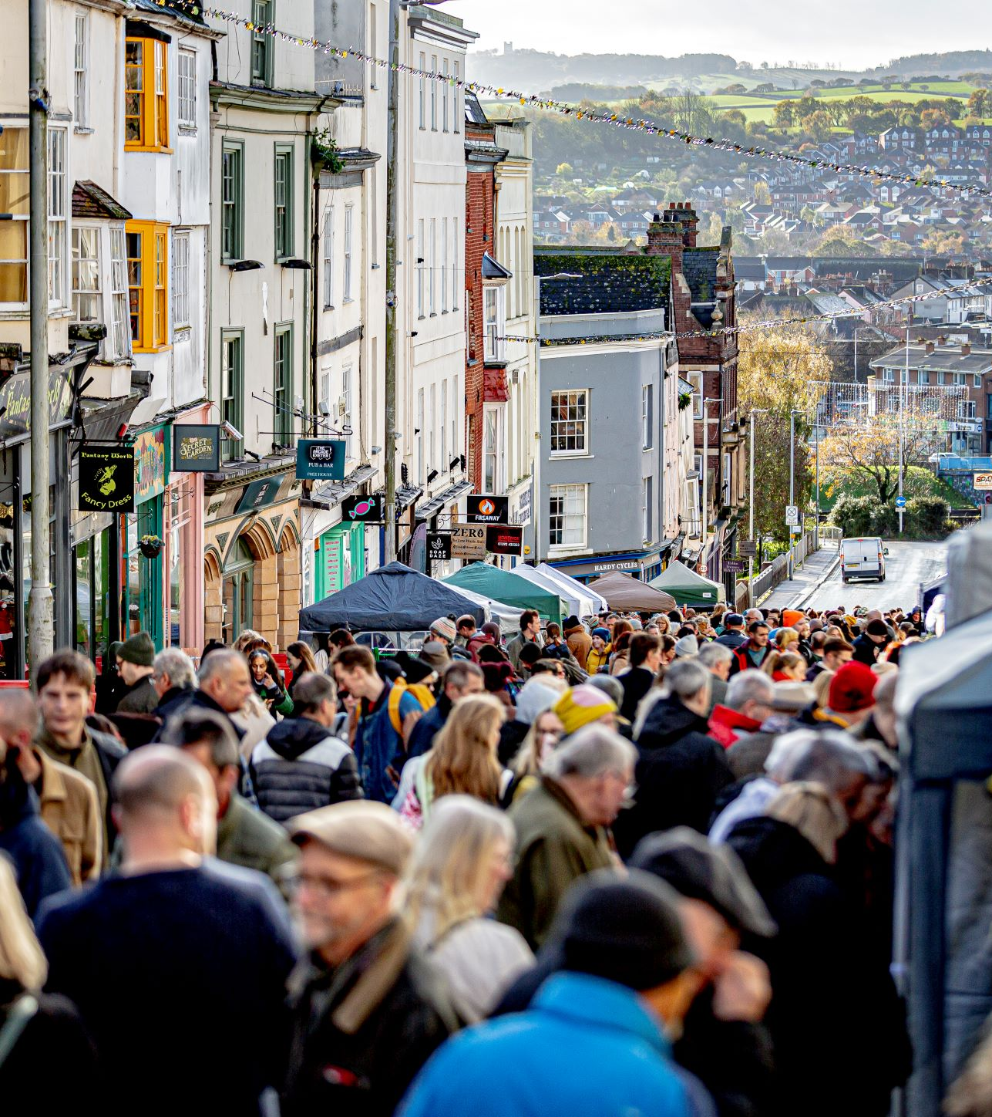

Discussion
What do you think makes a place great?

Slide 4
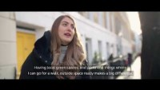
Notes:
https://youtu.be/Eq-WkhBMrIQ

Slide 5


Review
Did you identify any of the themes in the video?

Slide 6
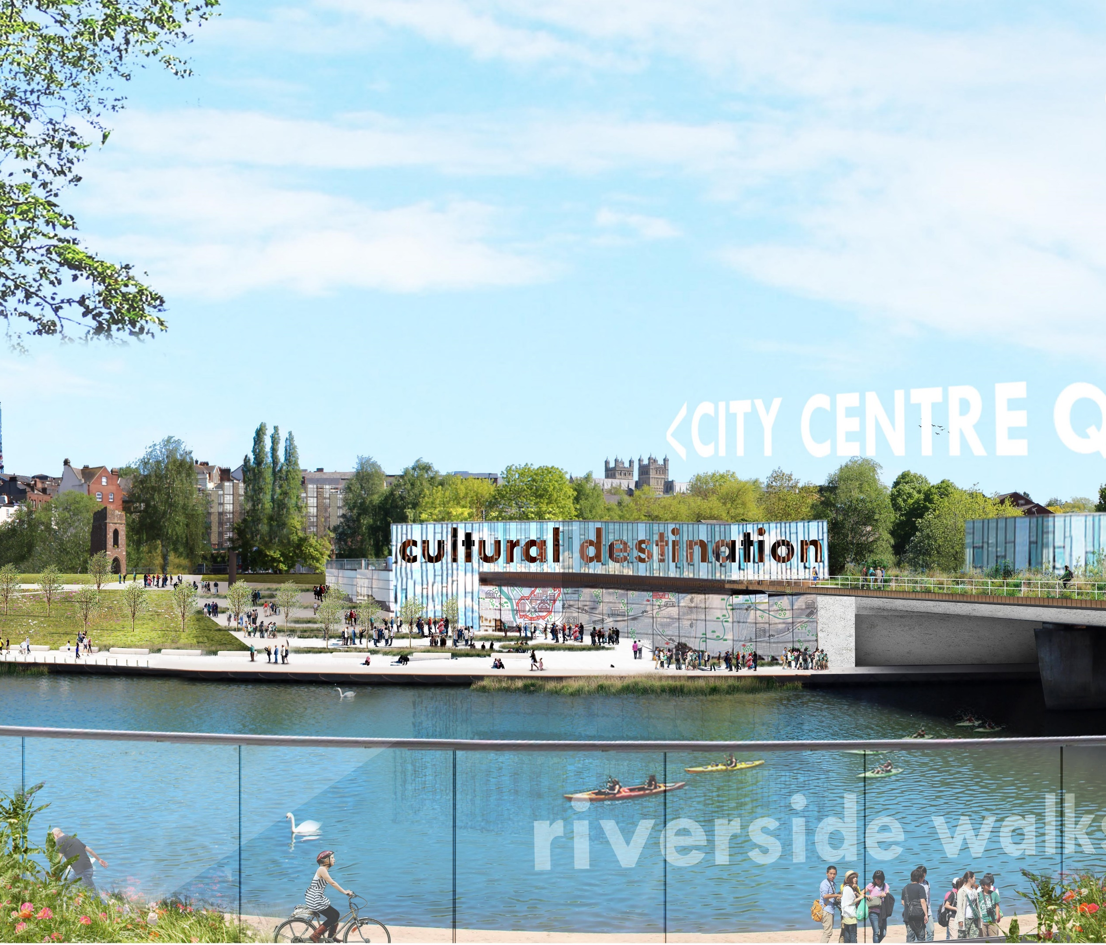
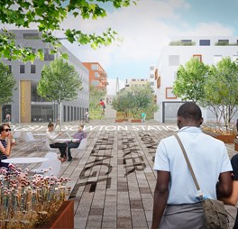

Learning Objectives
Learning Objectives:
We are learning ‘What is a liveable city?’
Learning Outcomes:
Identify what a ‘liveable city’ is and what ‘placemaking’ is
Describe the characteristics of a ‘liveable city’ and what it can provide
Analyse the process of ‘placemaking’ and how it can a community.

Slide 7
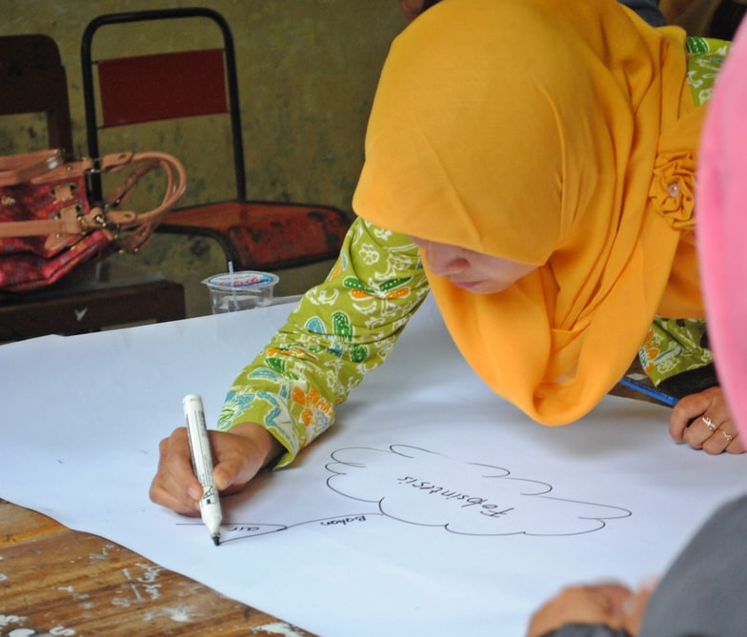
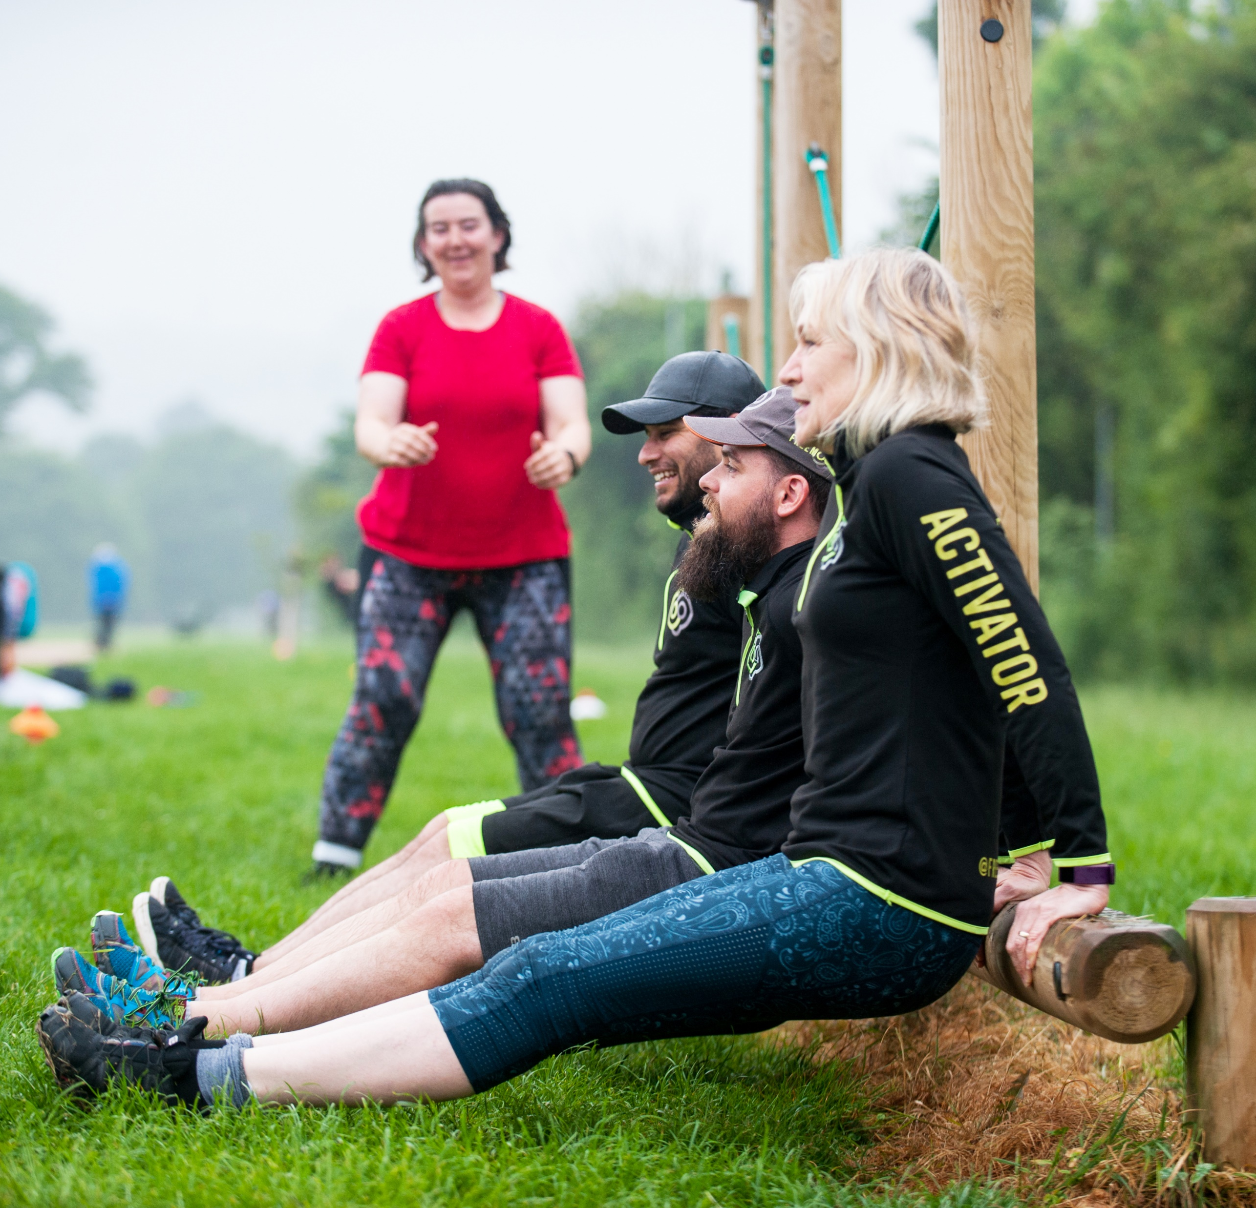

Activity
What do you already know about liveable cities?
Create a mind map to show your ideas.
Can you think of any examples of liveable cities, or have you visited any?

Slide 8
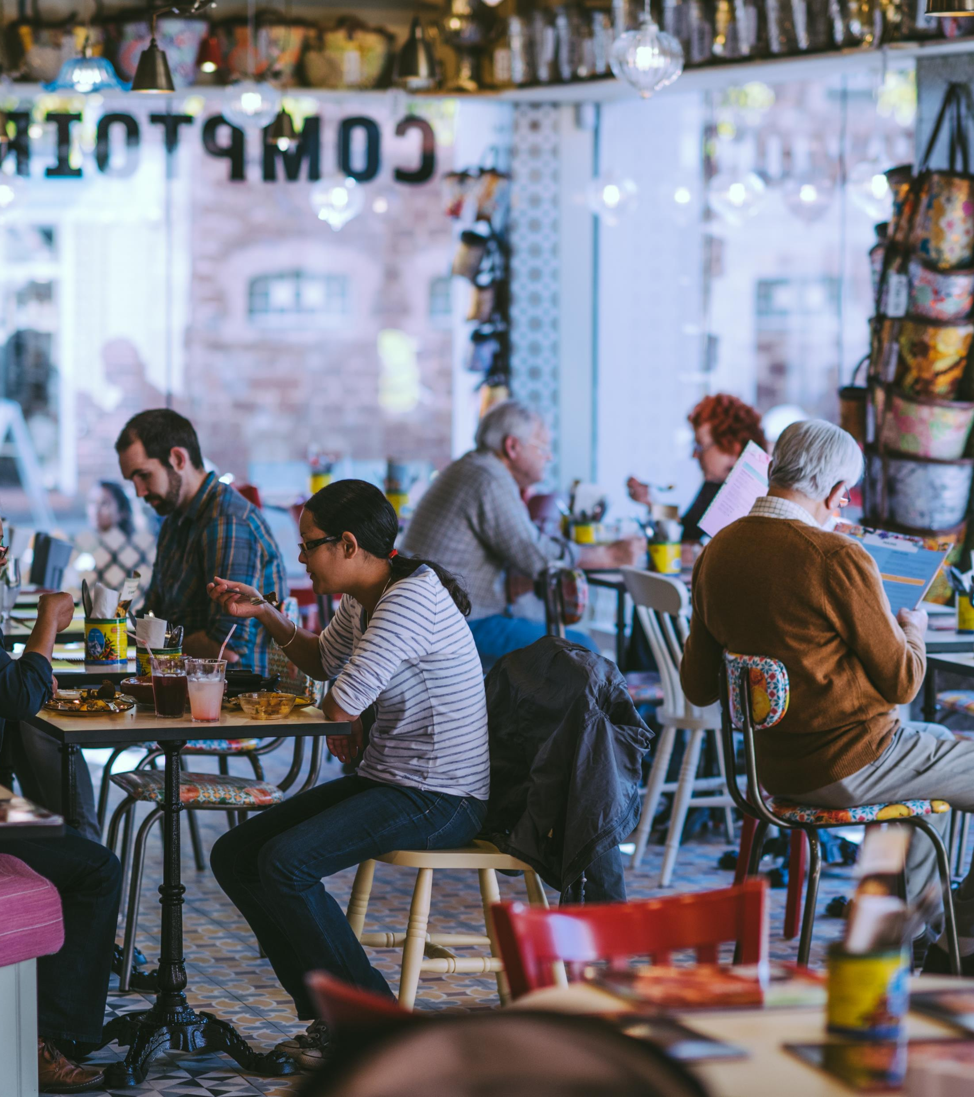

Identify what a liveable city is and what placemaking is
Using this definition to help you, complete the card sorting activity to consider which of the 8 statements describe ‘placemaking’ and which of them describe a ‘liveable city’.
Placemaking is the process through which we work together to shape our public space.

Slide 9

Describe the characteristics of a ‘liveable city’ and what it can provide
To explore this objective further we are going to:
Watch a video to learn more about Liveable Exeter
Complete a case study on Liveable Exeter, which includes one of the sites

Slide 10

Notes:
https://youtu.be/WX5e2EgbBL8?list=PLfqM7BLON9V878kaAXheeslAF-SJvKyLM

Slide 11


Liveable Exeter
will deliver over 12,000 homes on brownfield sites by 2040.
This means that the we need a different type of housing for the future: higher density.
By building at higher density, the city needs to address the quality of the environment, to ensure that development meets the needs of the community.

Slide 12

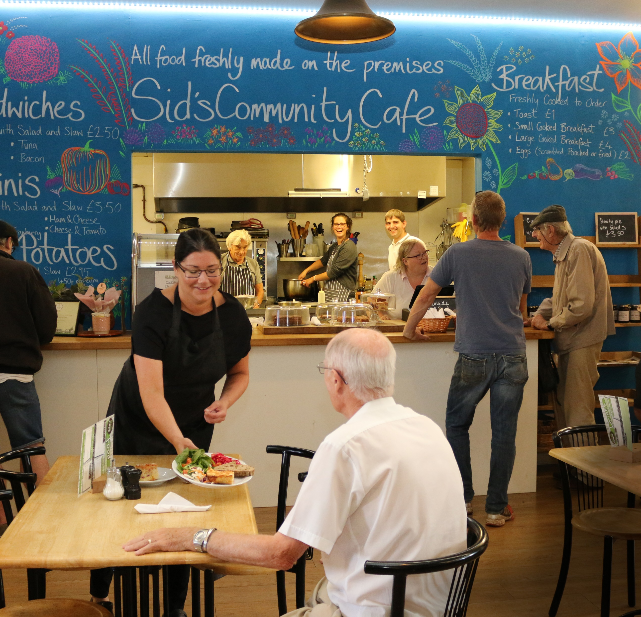

A ‘liveable city’ is a place where…
Where residents feel safe, and wellbeing is promoted
Socially connected and inclusive
Environmentally sustainable
A mix of housing, including social and affordable housing
Has walking and cycling infrastructure
Promotes access to nature and opportunity for biodiversity.

Slide 13
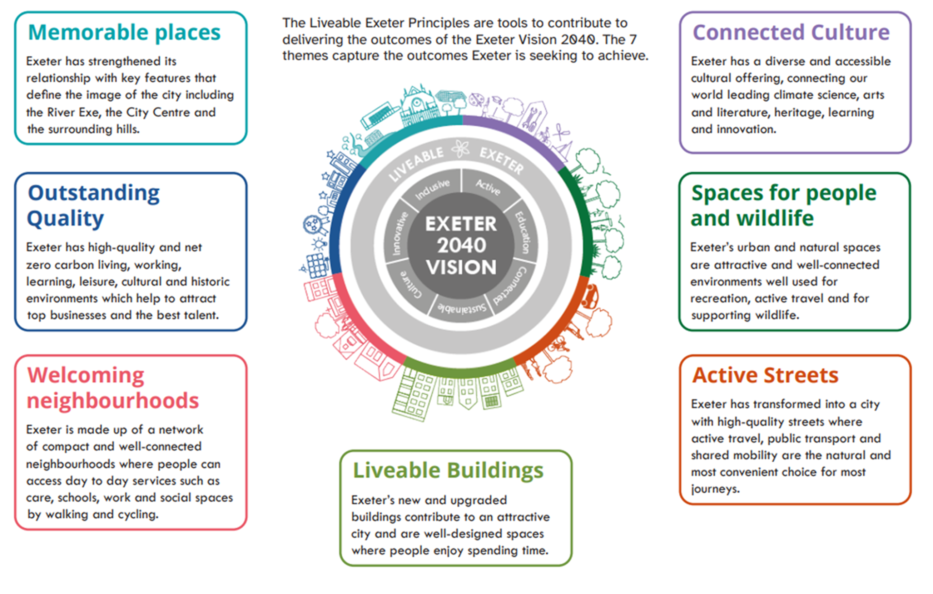
Activity
Review the Liveable Exeter Principles.
Would you choose to add anything different?

Slide 14
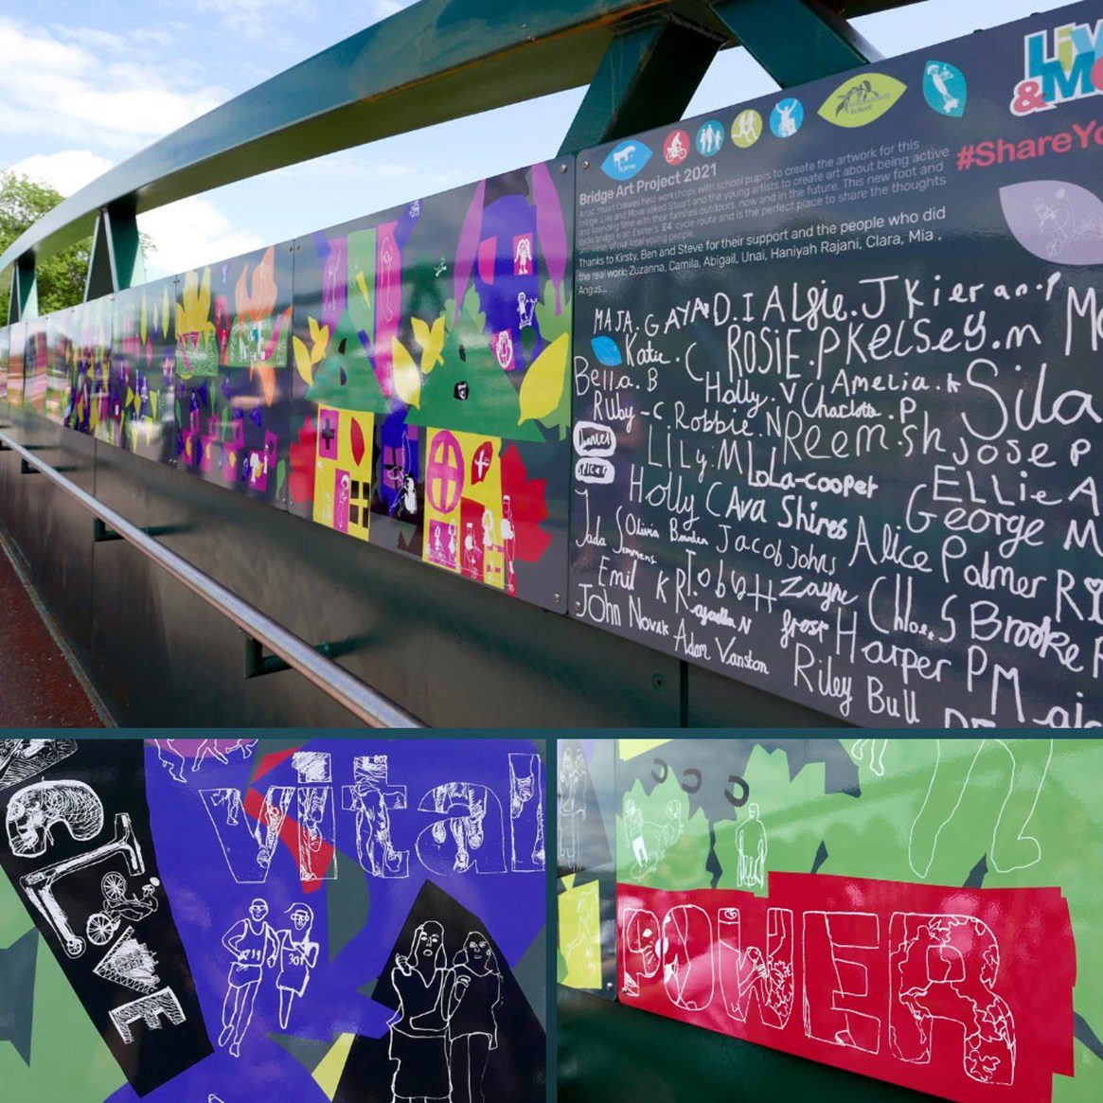
Analyse the placemaking process and how it can enhance a community
To explore this objective further we are going to develop our own design principles for the future of Exeter.
In small groups, draw up your own proposal for where you live. Your proposal should include:
A map
A minimum of three urban design principles
An explanation of how it will benefit place and community.

Slide 15
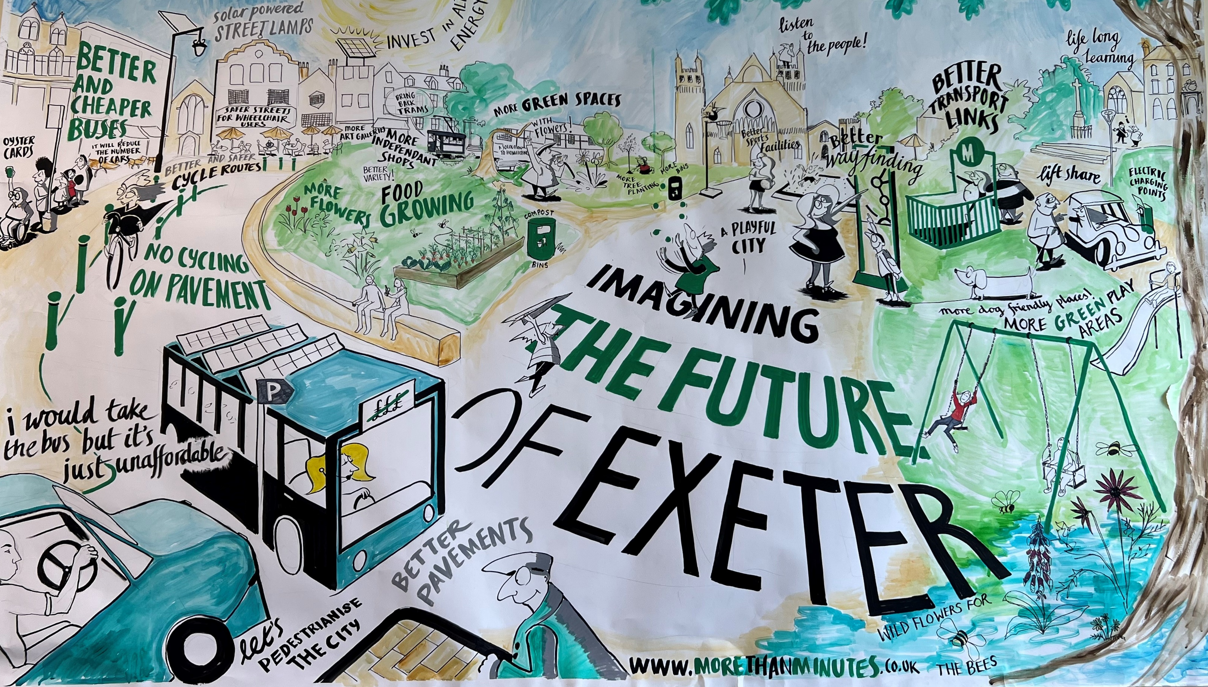

Review Activity
What have you learnt about liveable cities?
Return to your mind map.
Can you add something new you have learnt in a different colour?

Slide 16
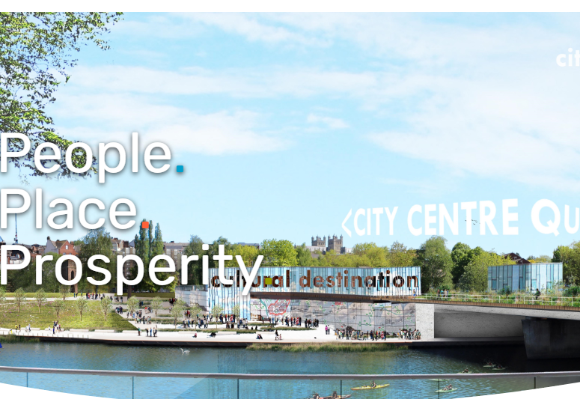
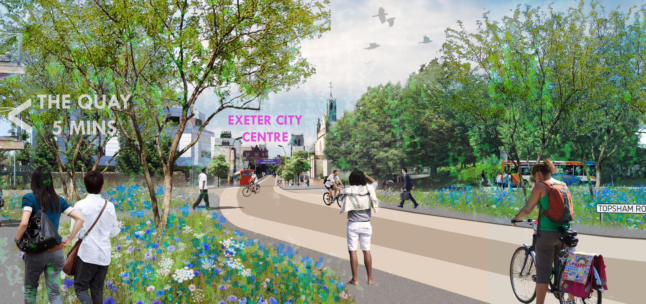
Find out more about Liveable Exeter
To find out more about Liveable Exeter visit
https://www.liveableexeter.co.uk/

